Slide 1
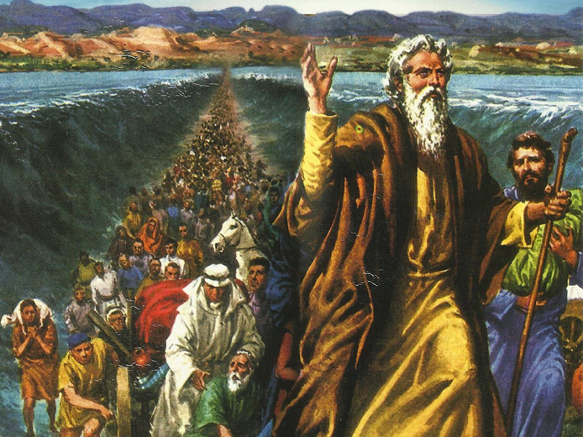
CATECHETICAL TEXTBOOK SERIES OF THE SYRO - MALABAR CHURCH
ON THE PATH OF SALVATION - 5
PEOPLE WHO AWAITED THE REDEEMER
5

Slide 2
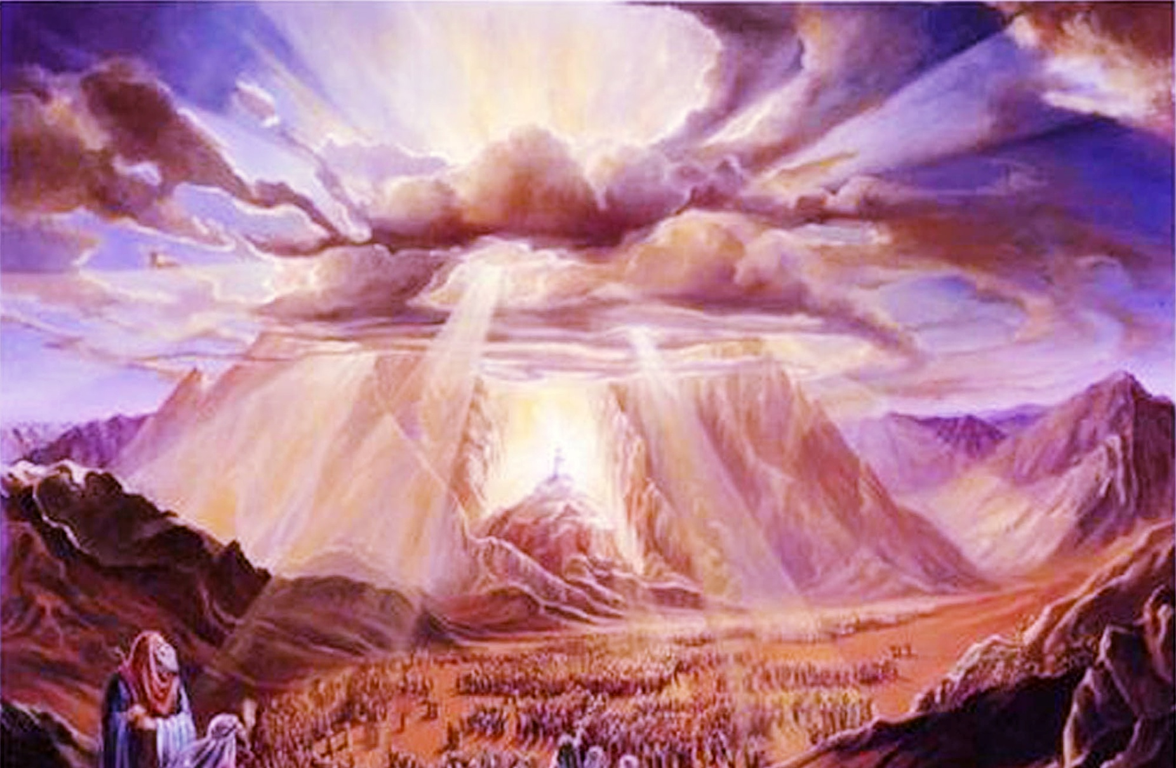
LESSON 8
THE COVENANT OF SINAI

Slide 3
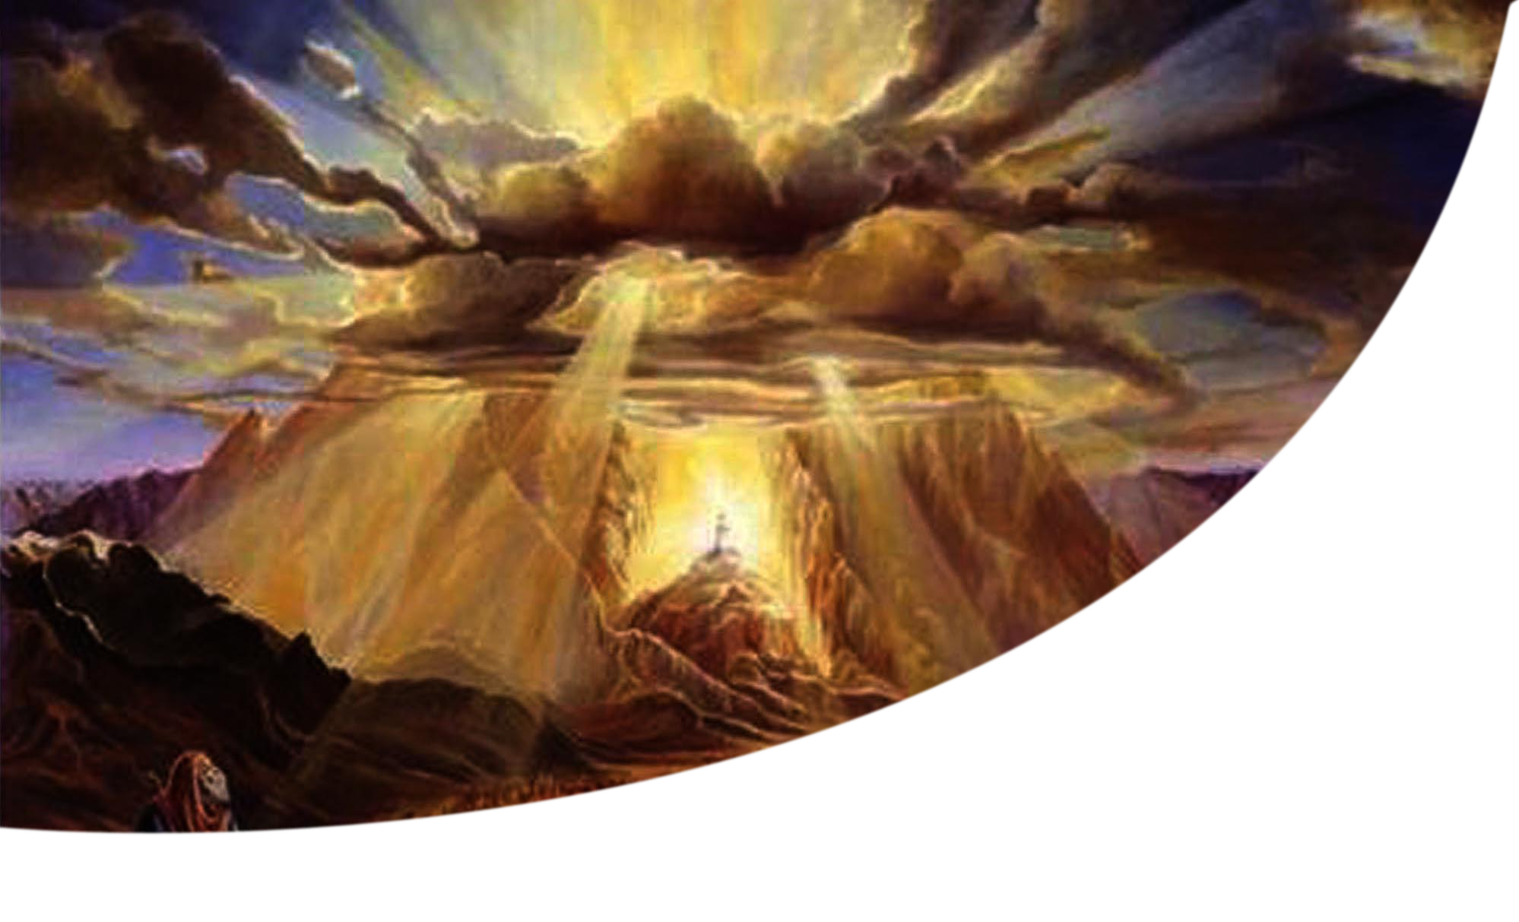
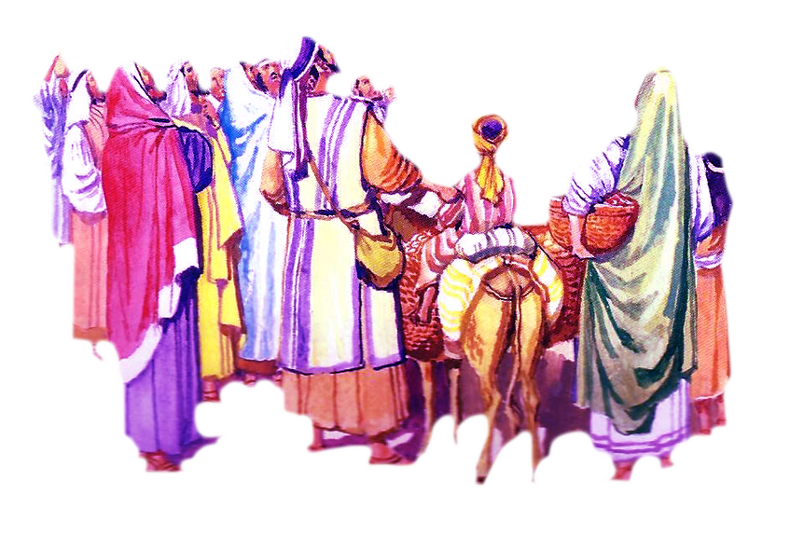
The Lord called Moses from mount Sinai and said: “ Thus you shall say to the house of Jacob, and tell the Israelites. You have seen what I did to the Egyptians, and how I bore you on eagles’ wings and brought you to myself.
New therefore, if you obey my voice and keep my covenant, you shall be my treasured possession out of all the peoples.

Slide 4
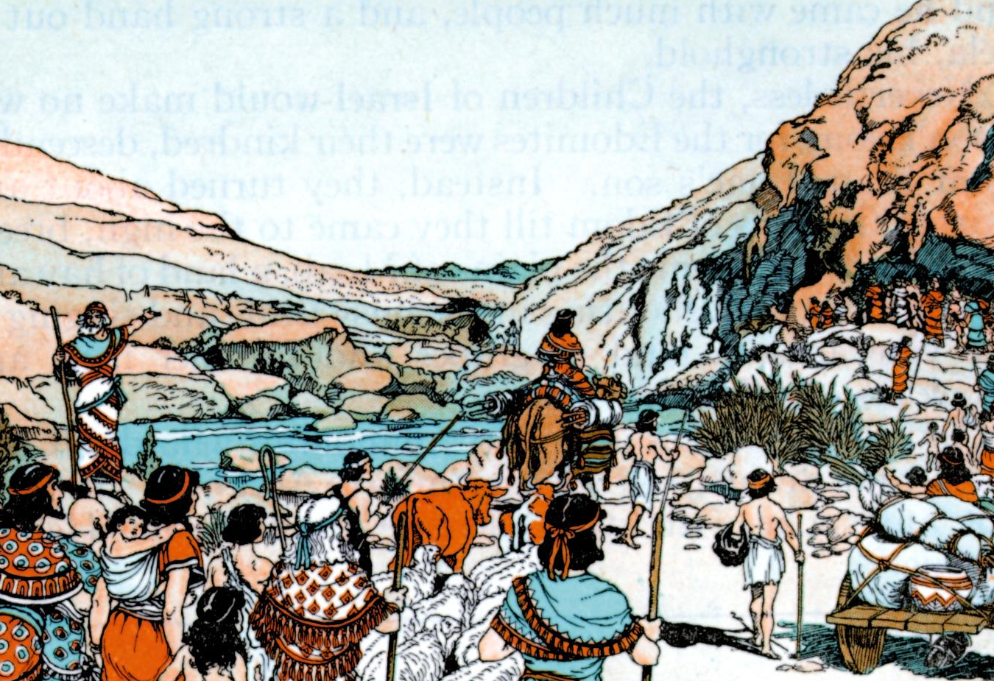
Consecration of god’s people
The Lord then said to Moses: “ Go to the people and consecrate them today and tomorrow. Haven them wash their clothes and prepare for the third day, because on the third day the Lord will come down upon mount Sinai in the sight of all the people” (Ex.19:10-11).

Slide 5

God on mount sinai
On the morning of the third day there was thunder and lightning. A dense cloud appeared on the mountain. A very loud blast of the trumpet was heard. This made all the people in the camp tremble in fear. When God came down on the mountain with thunder and trumpet blast, the Israelites were terrified out of their wits. They stood away as thy were too scared to see or hear Him. They were not bold enough to see for themselves the great glory of the Lord God. They said to Moses: “ You speak to us, and we will listen; but do not let God speak to us, or we will die” Ex. 20:19)

Slide 6

I am the Lord your God. You shall have no other gods before me.
You shall not make wrong use of the name if the Lord your God.
Remember the Sabbath day, and keep it holy, Six days you shall labour and do all your work. But the seventh day is a Sabbath to the Lord your God.
Honor your father and your mother, so that you days may be long in the land that the Lord your God is giving you.
You shall not murder.
You shall not commit adultery.
You shall not steal.
You shall not bear false witness against your neighbour.
You shall not covet your neighbour’s wife.
You shall not covet your neighbour’s house, slave, ox, donkey or anything that belongs to your neighbour (Ex. 20:1-17).

Slide 7
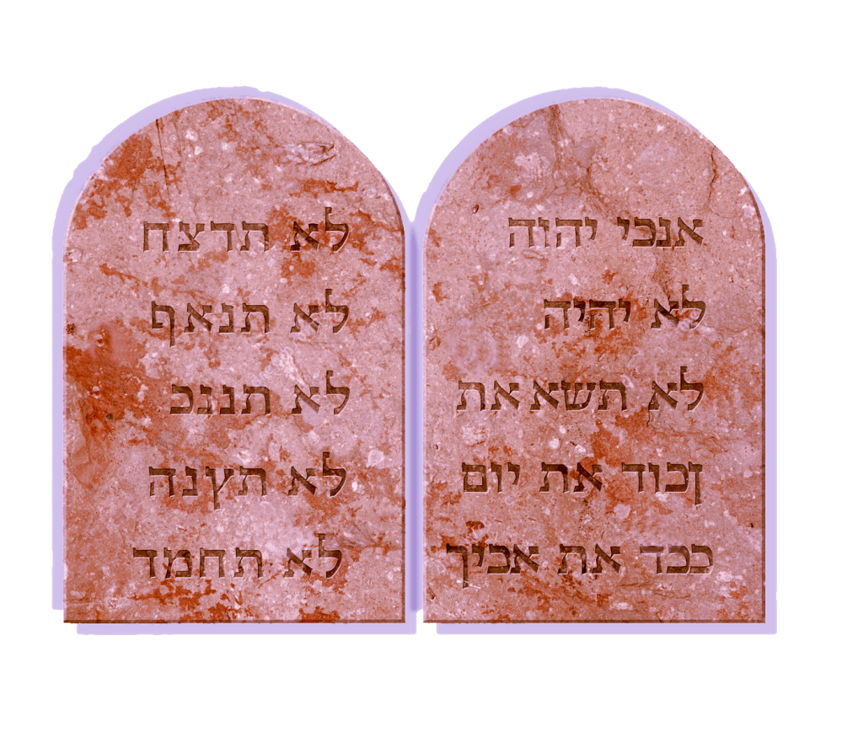
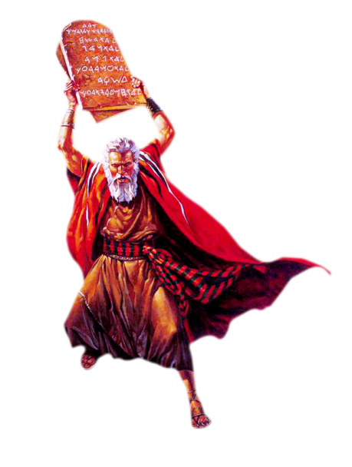
Handing ove the commandments
The Lord spoke to Moses: “ Come up to me on the mountain and wait there. I will give you the tablets of stone with the law and commandment which I have written for their instructions” (Ex.24:12).
These tablets had writings on both sides in God’s own hand.

Slide 8
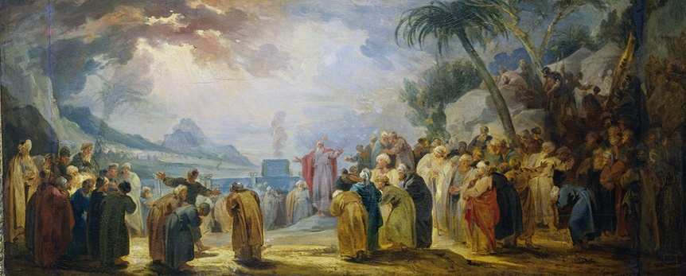
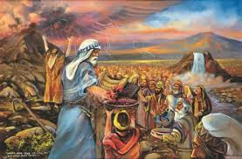
Sealing of the covenant
The Israelites received gladly the commandments that God gave them through Moses. Moses offered sacrifice to the Lord and sealed the covenant with the blood of the sacrifice. He poured half of the blood in basins and sprinkled the rest on the altar. Then he read the deed of the covenant for all the people to hear. Then they said: “ All that the Lord had spoken we will do and we will be obedient”. Then Moses sprinkled the blood on the people, saying: “This is the blood of the covenant that the Lord has made with you in accordance with all these words (Ex. 24: 6-8).
The commandments are the gift that God, the loving Father, has given to his children.
“ I will take you as my people and I will be your God ” (Ex. 6:7).

Slide 9
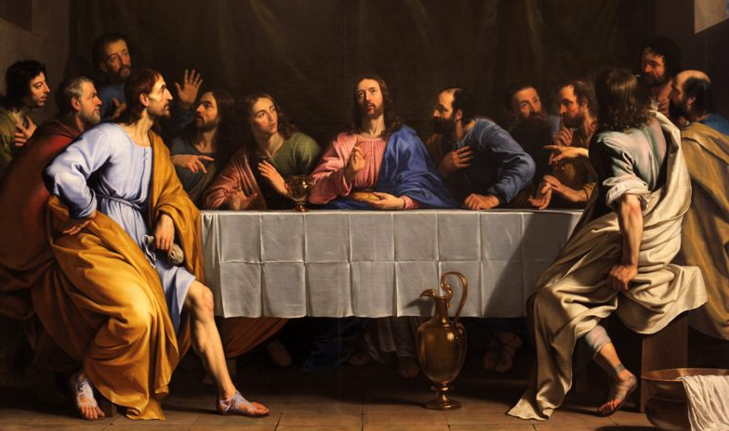
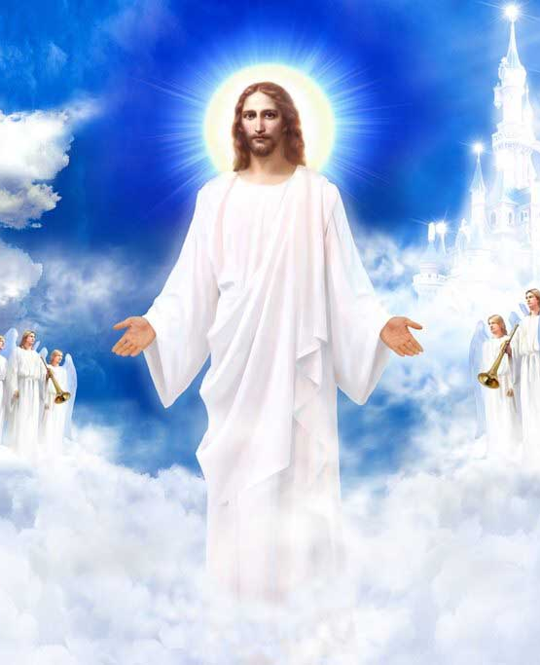
New covenant and new commandment
“ Jesus as I have loved you, you also should love one another. By this everyone will know that you are my disciples. If you have love for one another ” (John. 13:34-35).

Slide 10
Let us pray
O Lord who told me to love one another as you have loved, help me to lead a life according to your commandment of love.

Slide 11
READ AND RECOUNT
Narrate the event of the establishment of the covenant with Israel at mount Sinai (Exodus 20:1-17)

Slide 12

WORD OF GOD FOR GUIDANCE
“ I shall show steadfast love to the thousand of generation who love me and keep my commandments” (Exodus 20:6).

Slide 13
MY DECISION
Like the Israelites who became the people of God by keeping the commandments, I will also live as son/daughter of God by keeping His commandments.

Slide 14
LET US DO
Write down the ten commandments
I am the Lord your God. You shall have no other gods before me.
You shall not make wrong use of the name if the Lord your God.
Remember the Sabbath day, and keep it holy, Six days you shall labour and do all your work. But the seventh day is a Sabbath to the Lord your God.
Honor your father and your mother, so that you days may be long in the land that the Lord your God is giving you.
You shall not murder.
You shall not commit adultery.
You shall not steal.
You shall not bear false witness against your neighbour.
You shall not covet your neighbour’s wife.
You shall not covet your neighbour’s house, slave, ox, donkey or anything that belongs to your neighbour (Ex. 20:1-17).

Slide 15
LET US FIND OUT THE ANSWER
1. What is the promise that God gave to those who keep the covenant?
2. Which is the place where God gave the commandments to Moses?
3. What is the main content of the ten commandments?
4. What is the new commandment that Jesus gave us?

Slide 16
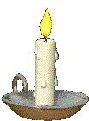


Thank you

